Slide 1
COMP 472
Mini-project Presentation
Team SandwichAI

Slide 2
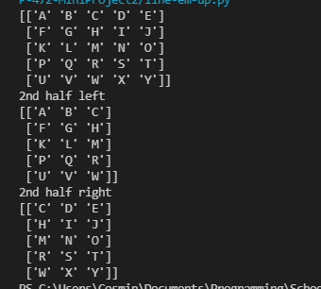
Heuristic e1()
Cut the board in half vertically and horizontally
Difference between the number of O’s and X’s

Slide 3
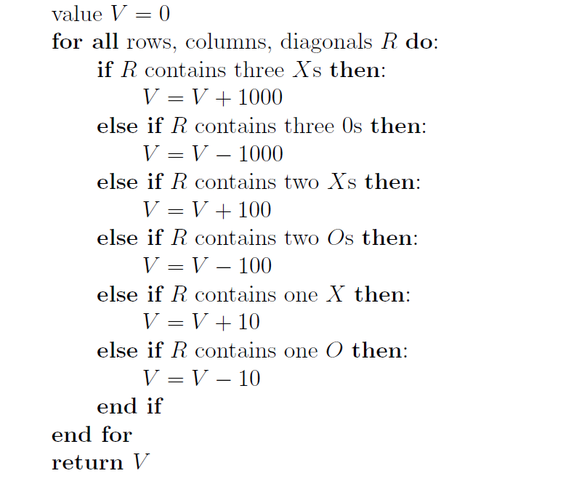
Heuristic e2()
Adaptation from the lab exercises
Increase decrease a score value depending on the number of X’s and O’s on that row/col/diagonal

Slide 4
Traces, outputs, scoreboard
Back to the code

